Slide 1

Lake Runner SA
By Logan Finley, Zaiden Espe, Nathan Nguyen,
Jenna-Luz Pura, Ian King, & Akhil Karri
Notes:
We’ll need to introduce ourselves one by one and describe our role (TL number, maybe quickly describe our feature)

Slide 2
Lake Runner
A “Reverse platformer”
The Player controls the environment instead of a character
The Surfer
Non Playable Character (NPC)
Runs in a constant direction with constant speed
On a mission to swim in the biggest lake of all (the Ocean)
The Player
The user of the game
Draws platforms to help or protect the Surfer
Uses items to enhance the Surfer’s abilities
Main goal is to keep the Surfer from getting bummed out
Notes:
Logan

Slide 3
Storyboard
Notes:
Everyone

Slide 4

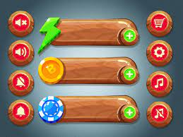
Storyboard 1
[ACTION]
The main menu can initiate gaming, load the desired level, display controls, and be used to adjust settings.
[NOTES]
The player can choose to play or change some settings, load his favourite level from the menu screen. The HUD will show his health and other resources he has or has collected in real time during his gameplay.
Notes:
Akhil: Show start menu

Slide 5
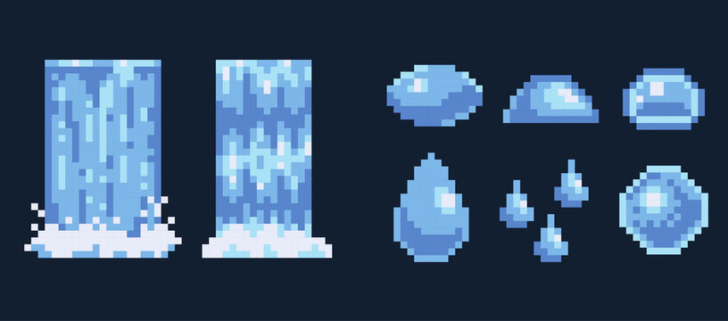
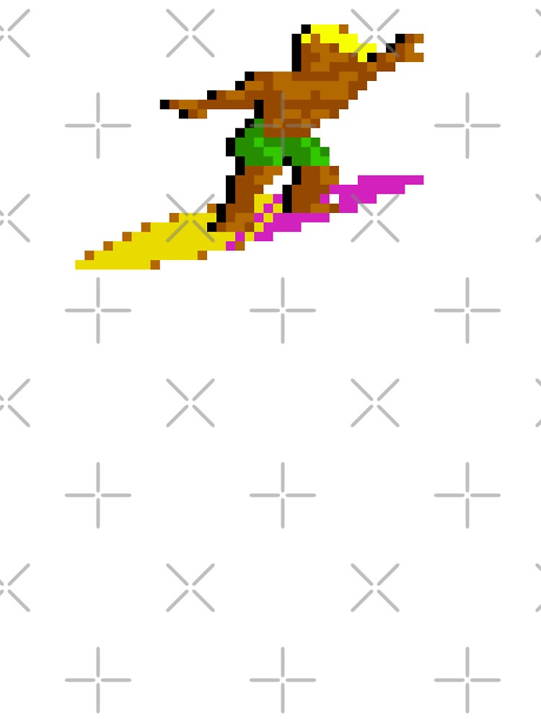
Storyboard 2
[ACTION]
The surfer chooses the next lake to run to.
[NOTES]
There is only a single path the Surfer can run.
Notes:
Jenna: Show overworld (level-select)

Slide 6
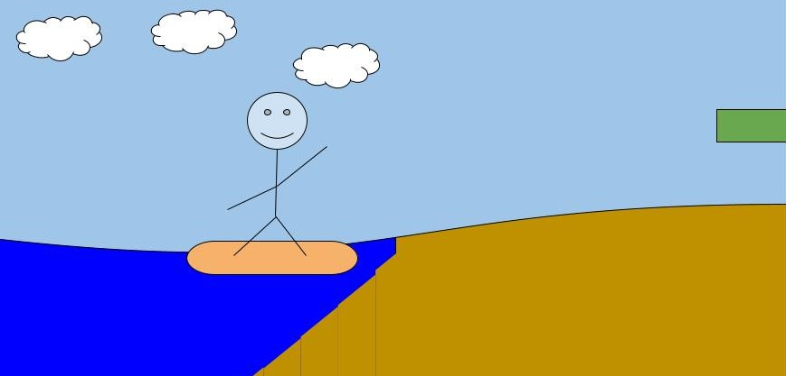
Storyboard 3
[ACTION]
The Surfer hits shore and must begin his run to the next body of water.
[NOTES]
Premade levels will be loaded ahead of time, Infinite Runner levels will be loaded constantly starting from this point.
Notes:
Ian: Show start point

Slide 7
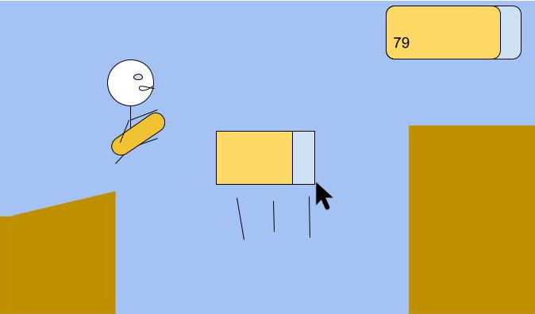
Storyboard 4
[ACTION]
The surfer jumps up towards a platform just drawn by the player.
[NOTES]
The platform resource bar is somewhat depleted by the action. A platform drawing and jump sound effect play.
Notes:
Zaiden: Show drawing a floating platform to jump a gap

Slide 8
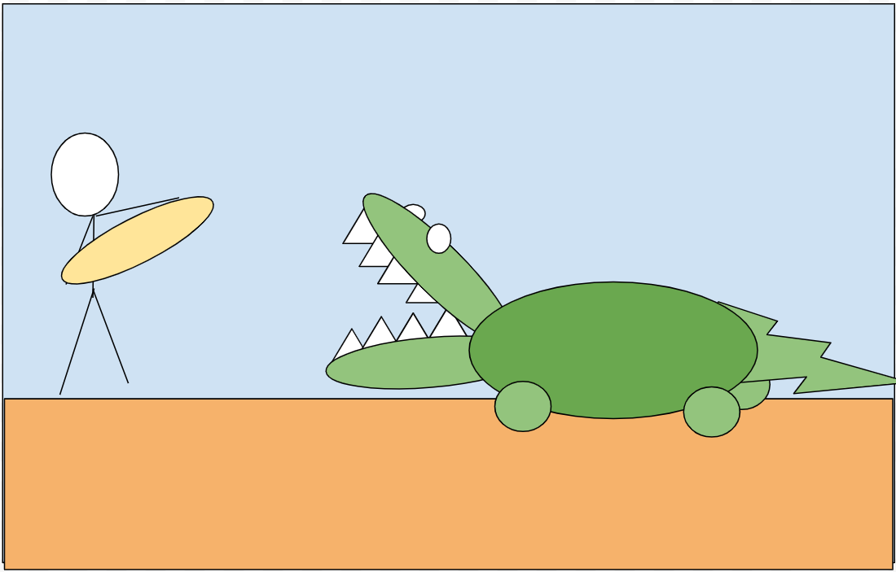
Storyboard 5
[ACTION]
The Crocodile approaches the surfer.
The player must find a way to protect the runner.
[NOTES]
The crocodile makes noises. If the runner runs into the crocodile, he will take damage.
Notes:
Nathan: Show a crocodile walking toward the character

Slide 9
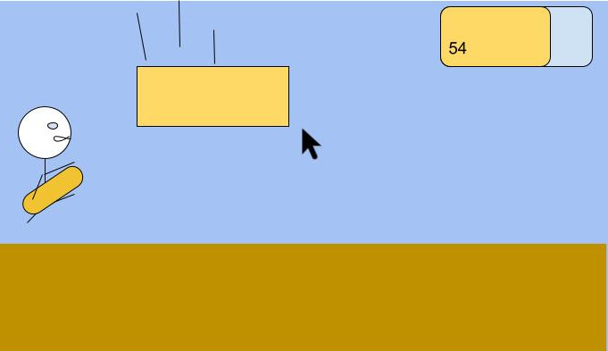
Storyboard 6
[ACTION]
The player draws a falling platform to crush the dangerous crocodile.
[NOTES]
A drawing sound, falling sound, and crushing sound are played. The resource bar is depleted more than the last platform because it is larger.
Notes:
Zaiden: Show drawing a falling platform to crush the crocodile

Slide 10
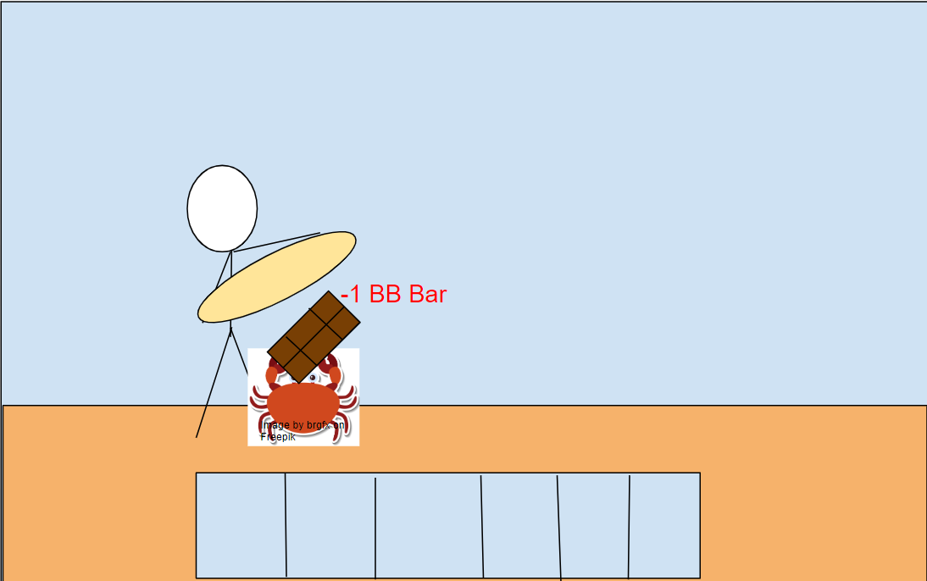
Storyboard 7
[ACTION]
The runner runs into a crab, and the crab steals a random item from the inventory.
[NOTES]
The crab makes sounds, and then the runner makes a sound signifying a loss of item, the item pops out of the player and appears on the crab.
Notes:
Nathan: Show a crab stealing an item

Slide 11
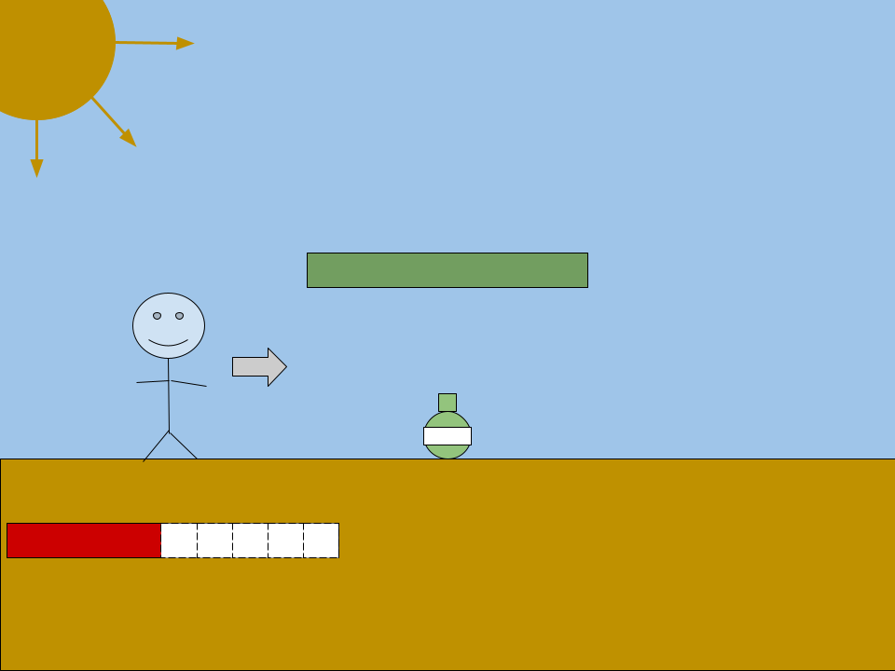
Storyboard 8
[ACTION]
The Surfer is running toward an Aloe Vera jar. The sun is lowering his health. An ‘X’ mark appears on the map
[NOTES]
A fire sound effect will play while the character is taking sun damage.
Notes:
Logan: Show picking up aloe vera

Slide 12
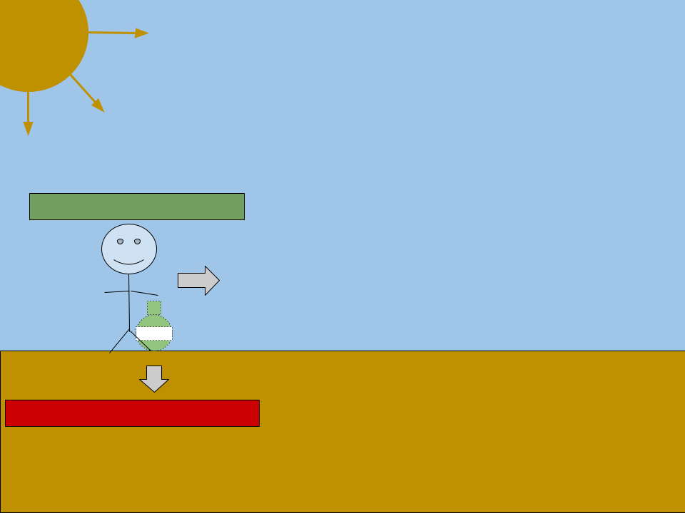
Storyboard 9
[ACTION]
The Surfer has picked up the Aloe Vera and gained health.
[NOTES]
A unique sound effect will play on item pick up.
Notes:
Logan

Slide 13
Storyboard 10
[ACTION]
The Surfer has picked up the Aloe Vera and gained health. The ‘X’ mark has disappeared.
[NOTES]
A unique sound effect will play on item pick up.
Notes:
Logan

Slide 14
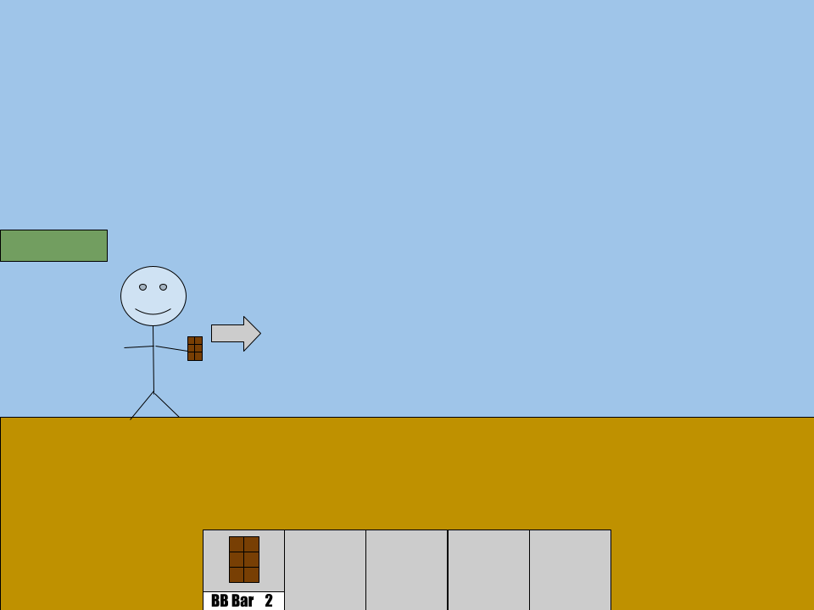
Storyboard 11
[ACTION]
The surfer has two Brain Blast Bars and is about to eat one.
[NOTES]
An eating sound effect will play on consumption of a BB Bar.
Notes:
Logan: Show using a brain blast bar

Slide 15
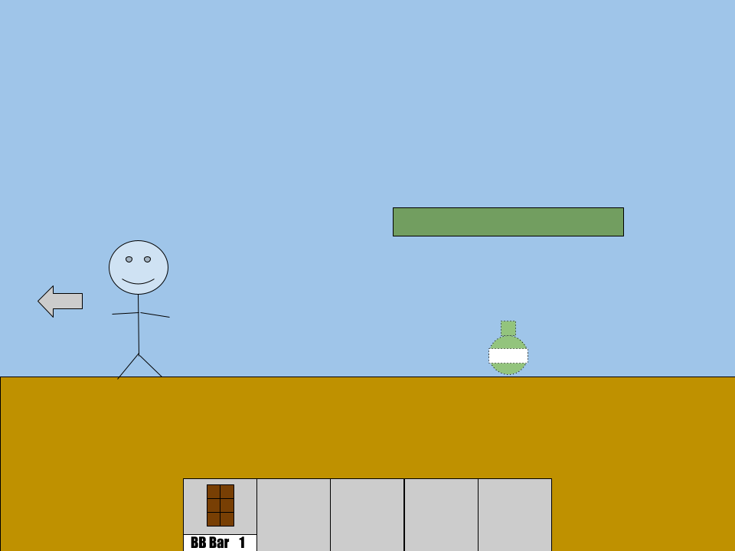
Storyboard 12
[ACTION]
The surfer has eaten a BB Bar and his direction has now reversed.
[NOTES]
The game music will be played in reverse while The Surfer is running backward.
Notes:
Logan

Slide 16
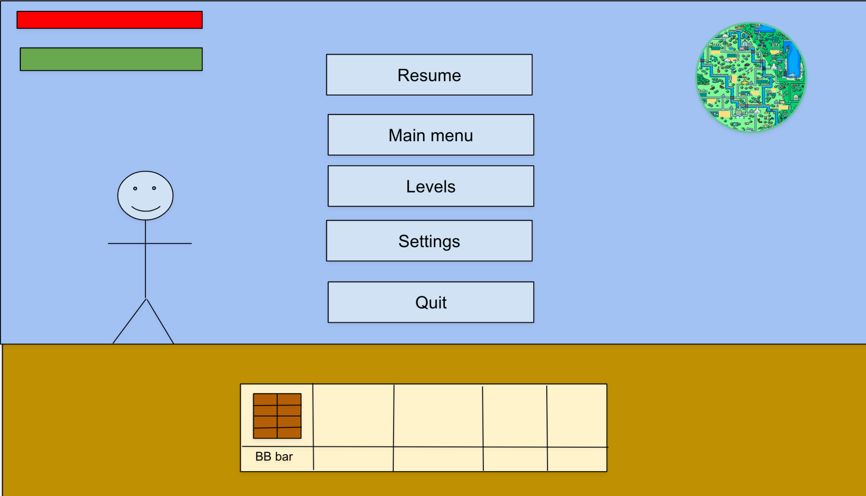
Storyboard 13
[ACTION]
In the midst of the game, the pause menu displays the same options as the main menu.
[NOTES]
The pause menu allows the player to restart, load a certain level, or modify settings, as well as see his health and other resources more clearly.
Notes:
Akhil: Show opening the pause menu

Slide 17
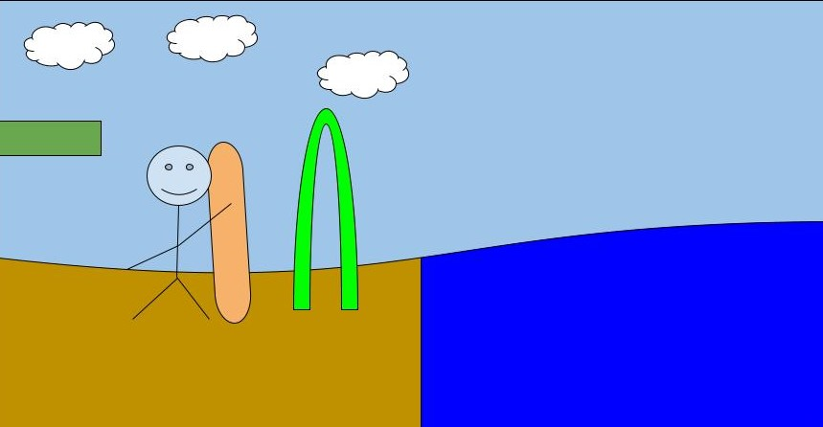
Storyboard 14
[ACTION]
The Surfer passes the finish line and surfs on the body of water until it’s time to start the next level!
[NOTES]
No finish line will be generated in Infinite Runner mode.
Notes:
Ian: Show the end of stage goal

Slide 18
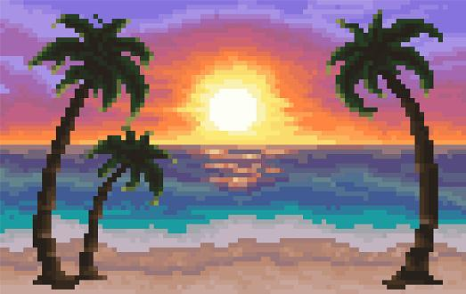

Storyboard 15
[ACTION]
The Surfer arrives at his long-desired destination: Malibu Surfrider Beach, California
Notes:
Jenna: Show the win screen

Slide 19
Context Diagram

Slide 20
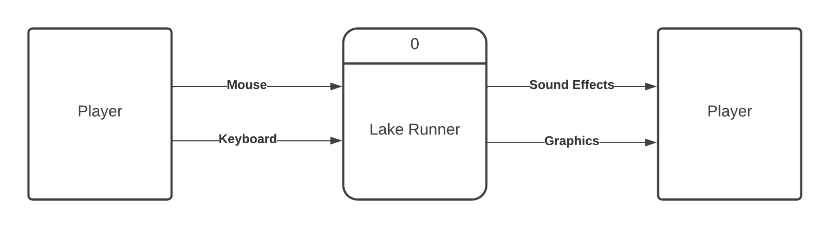
Context Diagram

Slide 21
The Vision
Notes:
Some screenshots with the ideas we have for what the game should look like and how it should behave

Slide 22
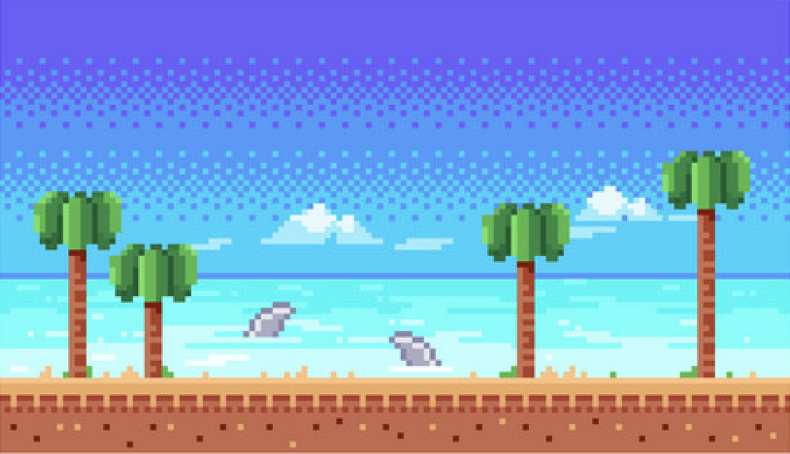



Vision

Slide 23
Diagram 0
Notes:
Everyone

Slide 24
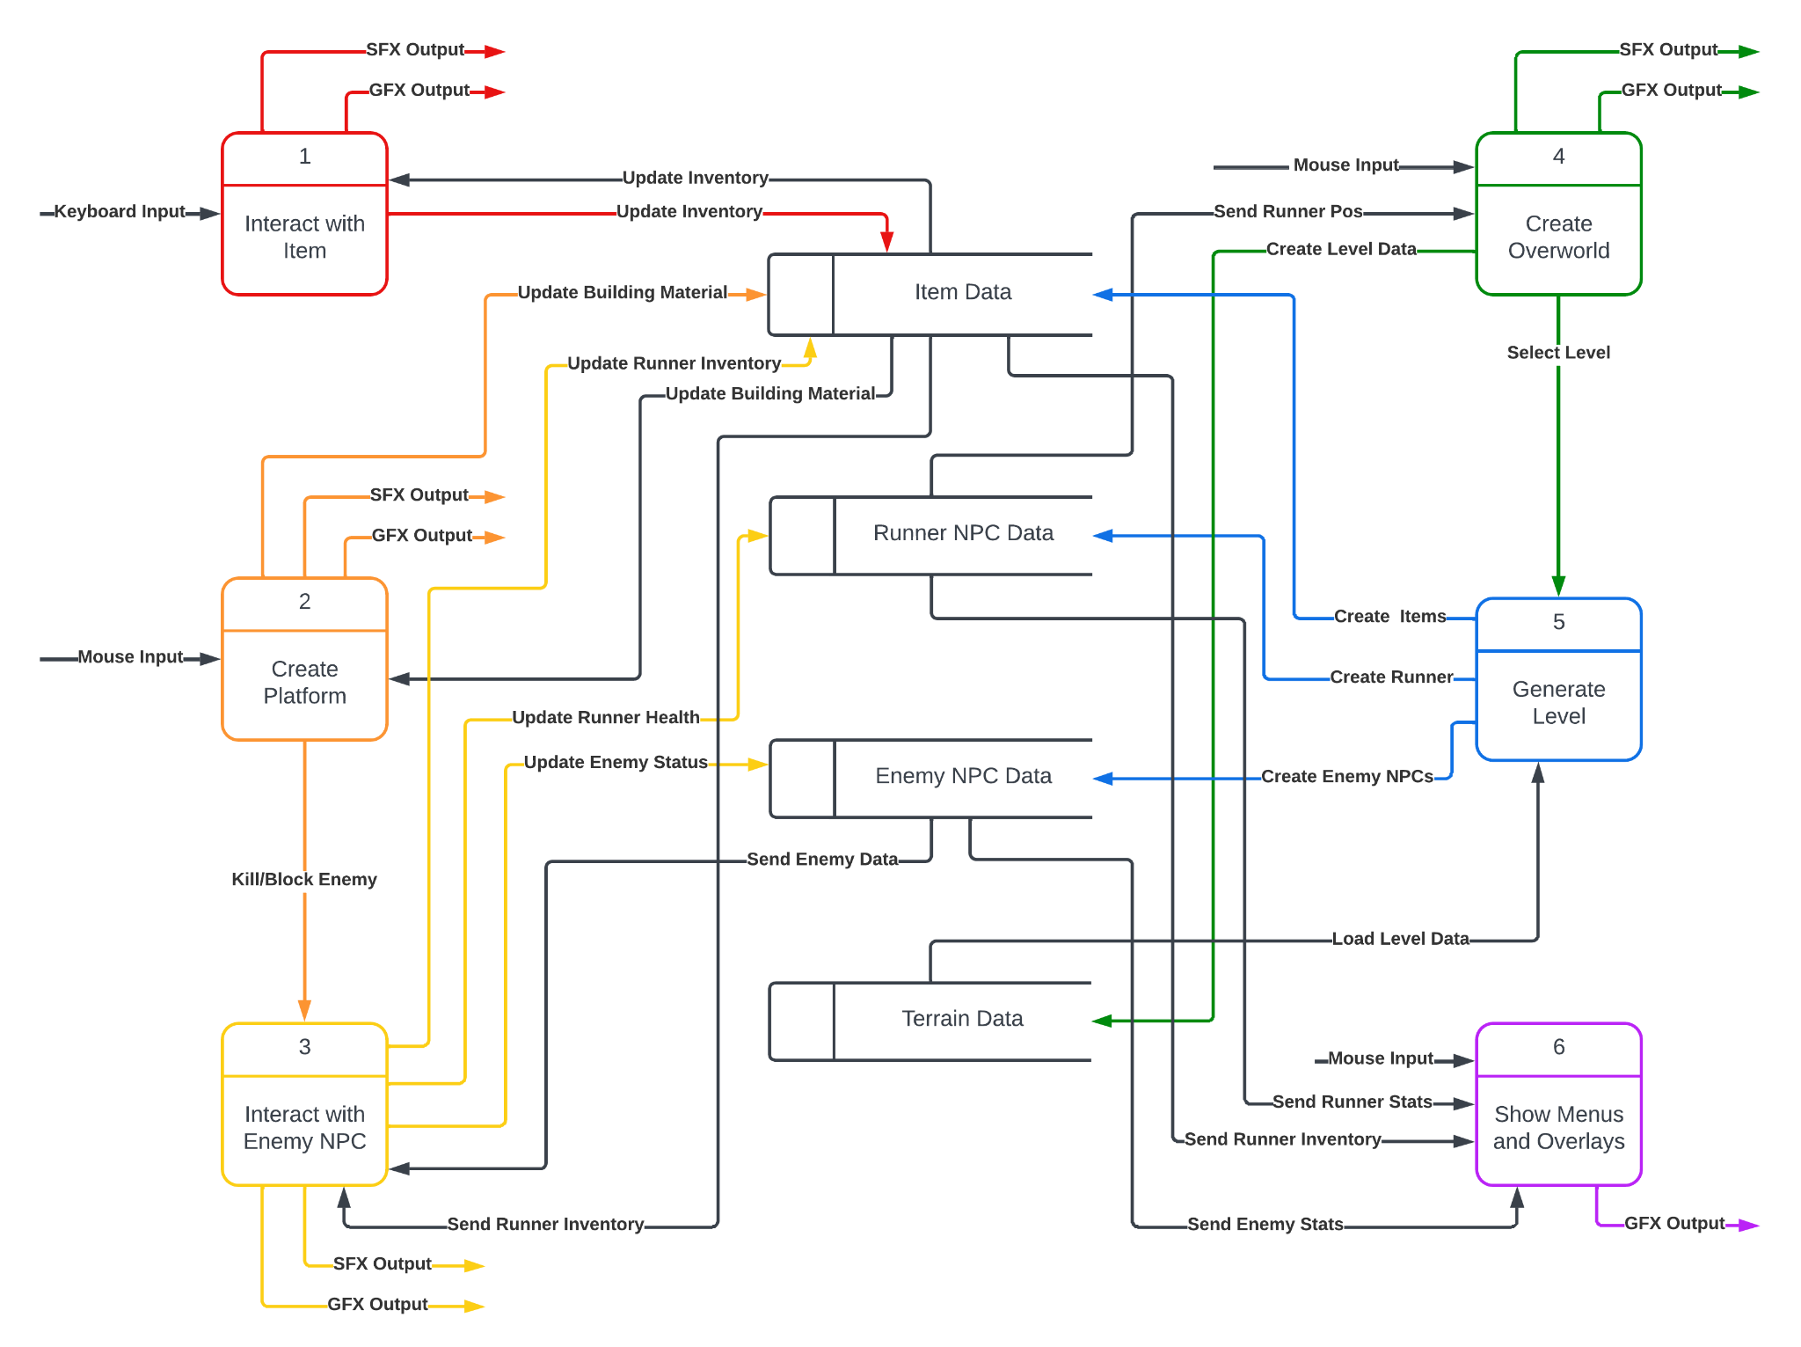
Diagram 0
Logan
Zaiden
Nathan
Jenna
Ian
Akhil
Notes:
Talk briefly about our respective processes

Slide 25
Global Use Case Diagram
Notes:
Everyone

Slide 26
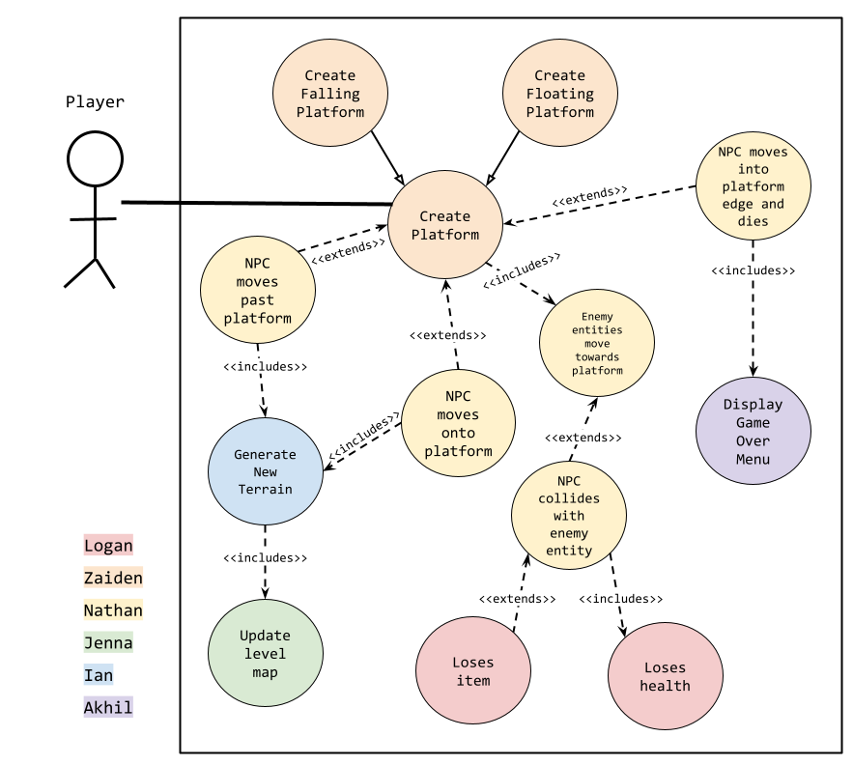
Use Case

Slide 27
LOGAN

Slide 28
Feature: Items, Collectibles
LOGAN
Brain Blast Bar
Reverses the direction of the runner for a period of time
Sunglasses
Zooms the camera out so more of the map is visible
Gives the player unlimited building material
High priority
May be too difficult without
Medium complexity
Lots of interactions with other features (UI, Runner NPC, etc)
Notes:
Describe the feature and explain its role in the project
How high of a priority is it?
What is the complexity compared to others?

Slide 29
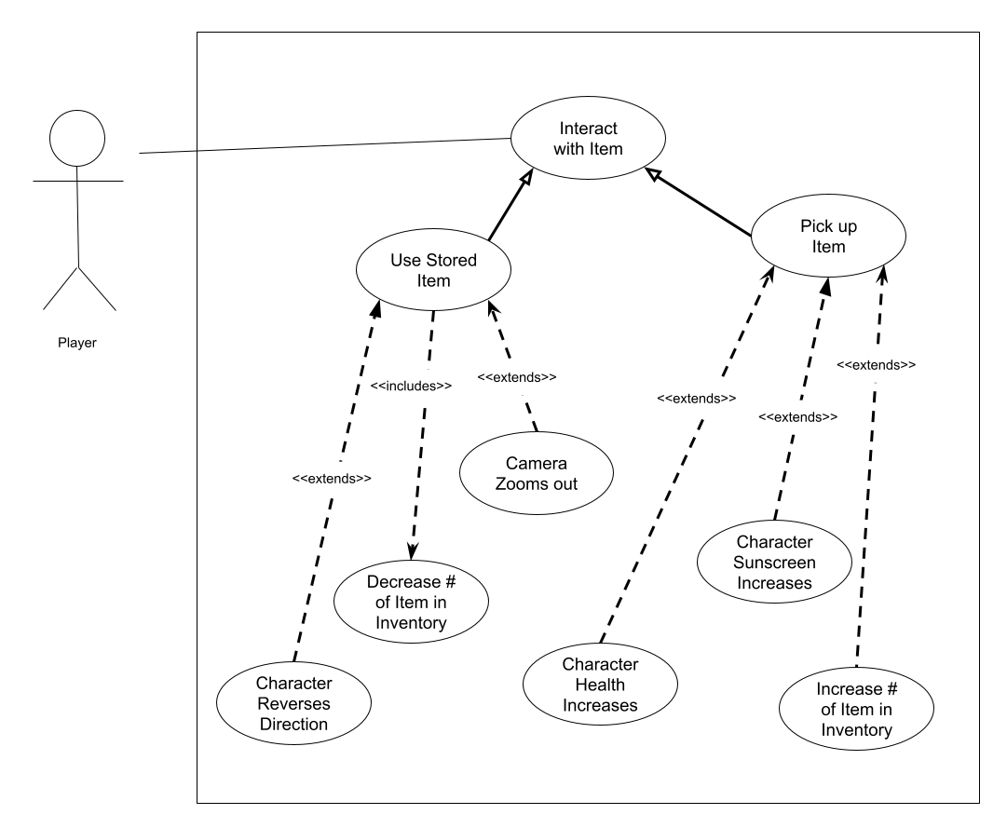
Use Case Diagram
LOGAN

Slide 30
Questions?
LOGAN

Slide 31
ZAIDEN

Slide 32
Feature: Platform Drawing
ZAIDEN
Platform drawing system
Draw rectangles on screen that actualize as platforms
Must check validity of each platform drawing (overlap, size, position)
Track resource to draw platform by area
Floating platform
Float in sky. useful for crossing empty or dangerous terrain, blocking out sun
Falling platform
Fall down. can crush enemies, other interesting mechanics possible
High priority system. Is main mechanic for user interaction with game. Is necessary to perfect to create interesting, difficult, and strategic game.

Slide 33
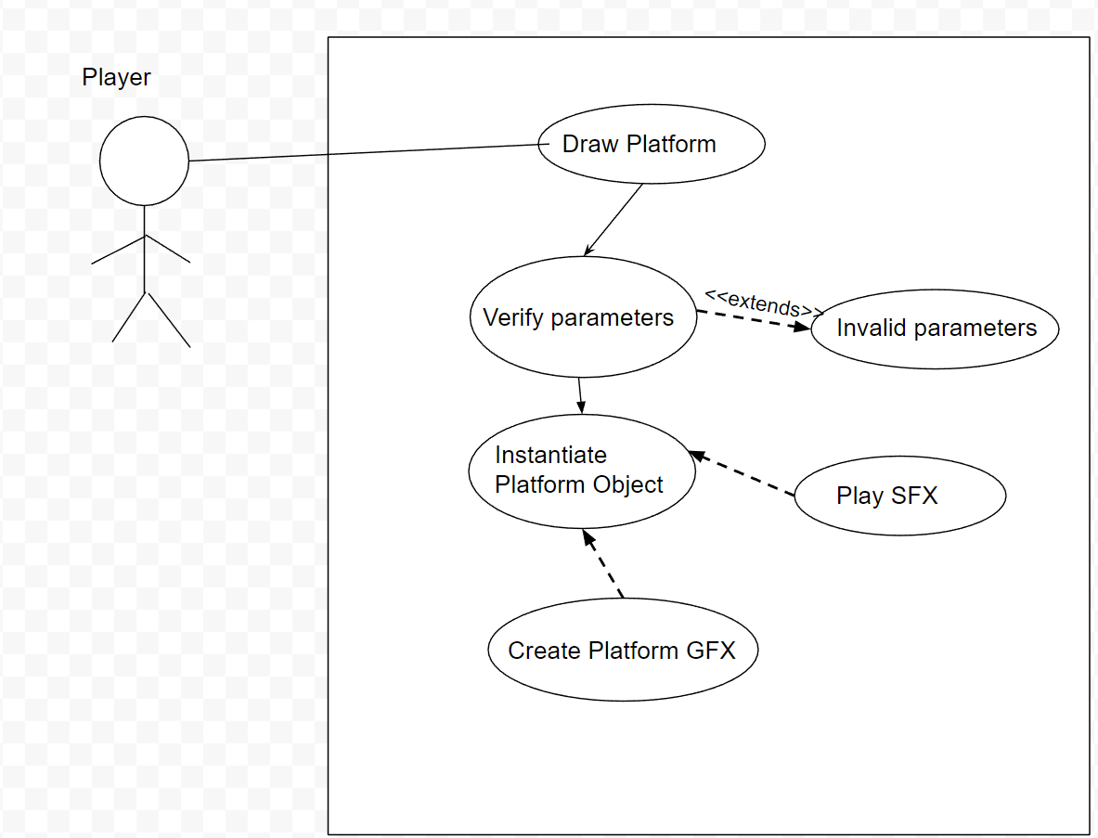
Use Case Diagram
LOGAN

Slide 34
Questions?
ZAIDEN

Slide 35
NATHAN

Slide 36
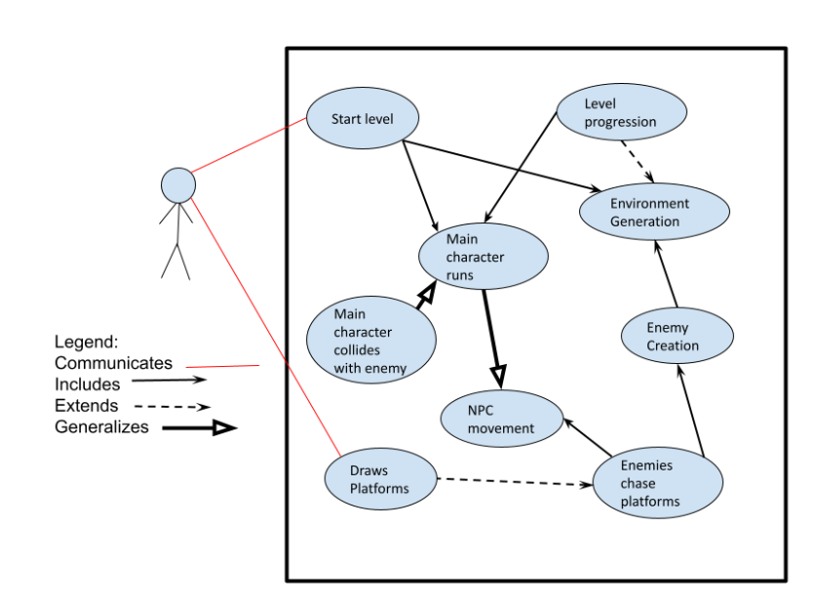
Use Case Diagram
NATHAN

Slide 37
Feature description: NPCs
NATHAN
This feature covers NPC animations, behavior and interactions. This includes Enemies as well as the main runner and his actions as he traverses the level.
This is a high priority feature for the runner, and medium priority feature for the other enemy NPCs
This feature has a medium complexity compared to the other features. The enemy AI and runner behavior may have some complex coding solutions.

Slide 38
Questions?
NATHAN

Slide 39
JENNA

Slide 40
Feature: Overworld & Inter-level Map
JENNA
Overworld Mapping System
Overview of all levels
Outlines the order of levels
Displays high score (if any)
Displays current inventory
High priority
A comprehensive way to advance between levels
Medium complexity
Loads each level
Fetches and displays high score and inventory
Inter-level Mapping System
Start & end lake
Item locations
Enemy locations
Last died location
Low priority
Game is functional without
Can make it more interesting
High complexity
Tracks the location of NPC
Has to know item & enemy location

Slide 41
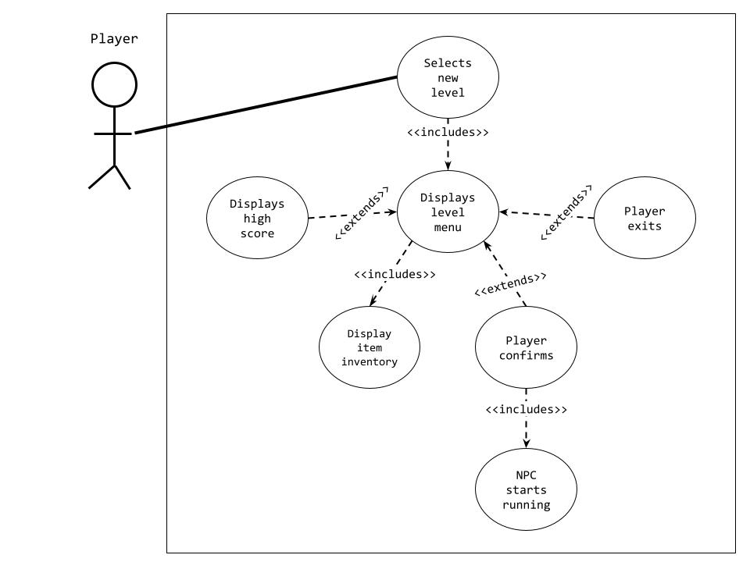
Use Case Diagram
JENNA

Slide 42
Questions?
JENNA

Slide 43
IAN

Slide 44
Feature: Infinite Runner Mode
IAN
Random World Generation
The level is continually generated from a list of possible platform combinations.
Items and enemies are added to this level in areas accessible to the player.
Item and Enemy Control
Specific item and enemy quantities are monitored to keep the player from being flooded with the same contents.
Medium Priority
Not necessary to play the game, but adds replayability.
Medium complexity
Monitoring object spawns and placing them in the correct locations can get complicated.
Notes:
Describe the feature and explain its role in the project
How high of a priority is it?
What is the complexity compared to others?

Slide 45
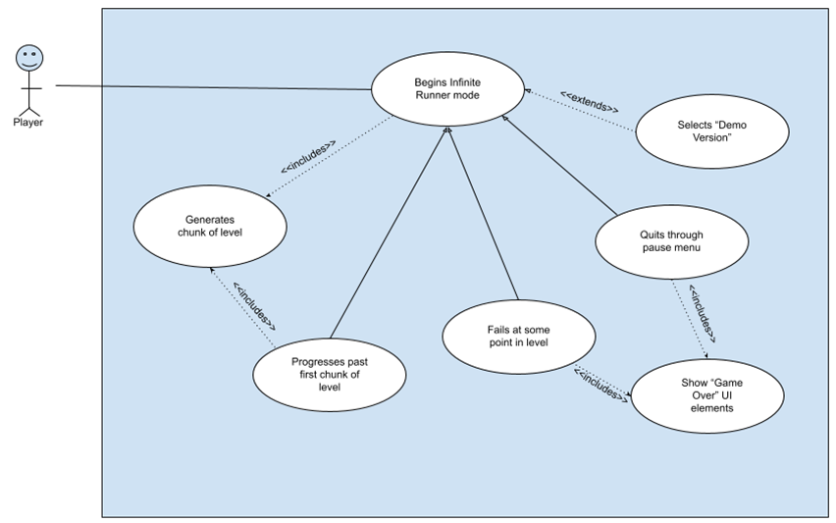
Use Case Diagram
IAN

Slide 46
Questions?
IAN

Slide 47
AKHIL

Slide 48
Features: UI, HUD, Inventory
AKHIL
Main menu, Pause menu, Gameover screen
The main menu comes once the game is started to give the player the options to select to change the settings, to see the controls or to play the game. And he can select the level he wants to play.
HUD/inventory
The player will be shown the health and resources he is having while playing the game.
High priority
The hud is important for the player to use the items and to know his health to so that the player can play more consciously. Since, this game mostly depends on resources the player collects. The menu is useful for player to play his favourite level.
Low-Medium complexity
Need to fetch the stats of every item and health and monitor the resources if they are used.

Slide 49
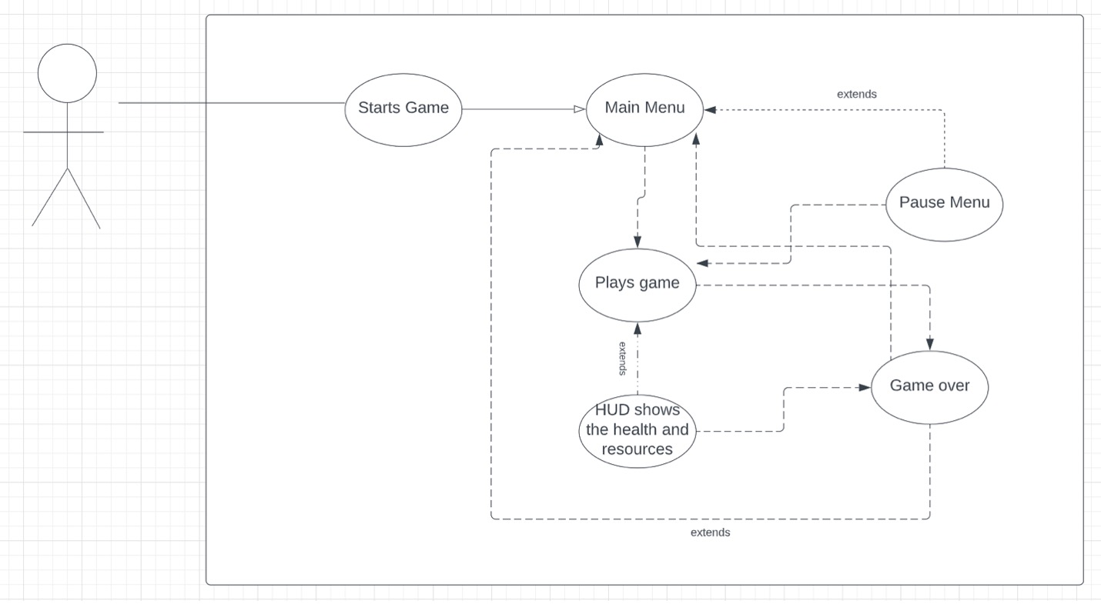
Use Case Diagram
AKHIL

Slide 50
Questions?
AKHIL

Slide 51
More
Questions?

